Slide 1
Minor
Fit for the Future
Responsieve Methodologie
samen doen → samen leren → samen doen → samen leren → samen doen → samen leren → samen doen → samen leren → samen doen → samen leren → samen doen → samen leren → samen doen → samen leren → samen doen → samen leren → …
30 oktober 2019

Slide 2
Facilitator of Change
Een Facilitator of Change begrijpt de verschillende belangen en opvattingen van stakeholders gerelateerd aan wereldwijde en lokale ontwikkelingen, en is in staat om strategische interventies te ontwikkelen voor duurzame transities in de betreffende regio.

Slide 3
Competenties en
Onderzoekende houding
Competenties
  Conceptueel denken
    Systeemdenken, van hard via zacht naar kritisch
  Kritisch reflecteren
    Laws of Form
    Tweedeordeobservaties
  Verbinden
    Relaties
    Ethiek
Onderzoekende houding
  Responsieve methodologie
  Reflexieve monitoring

Slide 4
Inhoud
Verbinding leggen tussen SSM en responsieve methodologie in het algemeen en SSM – finding out en interviewtechnieken in het bijzonder
Responsieve methodologie
Interviewtechnieken

Slide 5
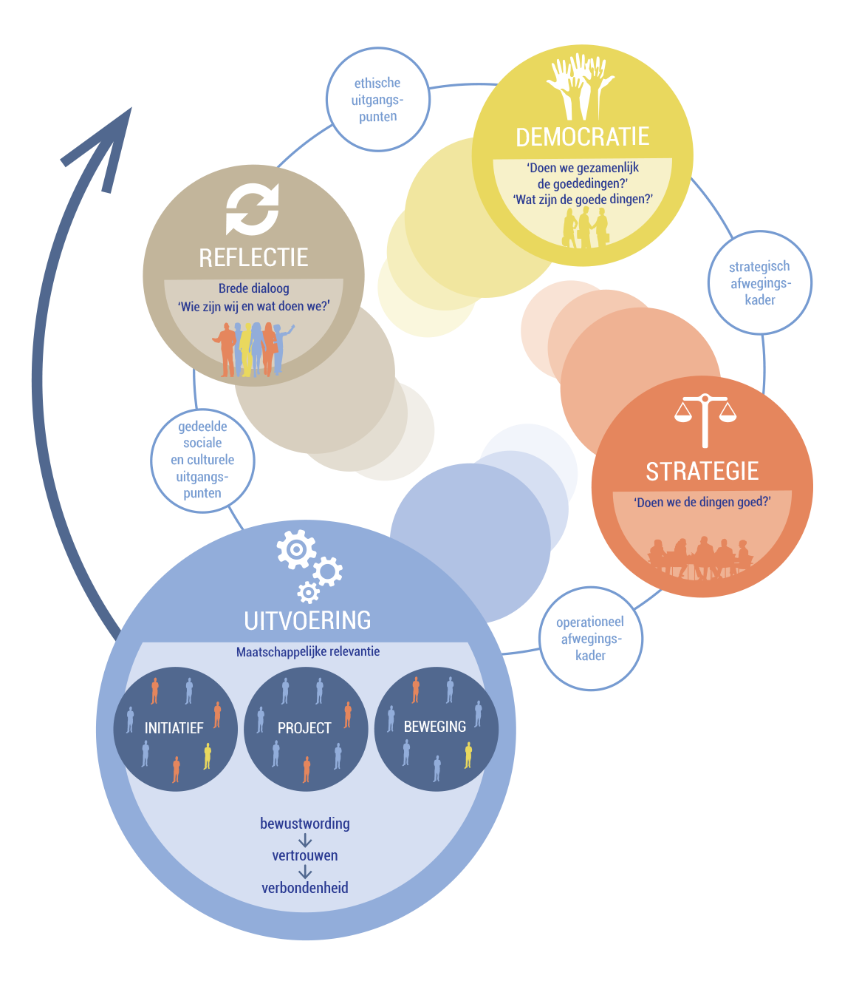
Duurzame, samenlerende maatschappij

Slide 6
Rode draden
  Inhoud-gedreven proces:
    Project staat centraal met de eigen inbreng van de deelnemer in relatie tot anderen: samen doen, samen leren, …;
    Driedubbelslag:
      Voortgang brengen in situatie (arguably desirable, culturally feasible, 3/5 E’s);
      Met nieuwe competenties (conceptueel (systeem-)denken, kritische reflectie, verbinden);
      Met (meta)reflectie, geleerde lessen;
  Sturen op ethische uitgangspunten (wie zijn we, wat doen we?):
    Verificatie → validatie;
    Brede dialoog:
      Draagvlak bij belanghebbenden;
      Druk op democratisch proces;
    Doorvertaling naar afwegingskaders en leidende principes;
  Laws of Form:
    Tweede-orde cybernetica (met rol van observer);
    Autopoiese (zef-productie, Luhmann);
    Tweede-orde observaties, kritische reflectie;
  Ethics of care.

Slide 7
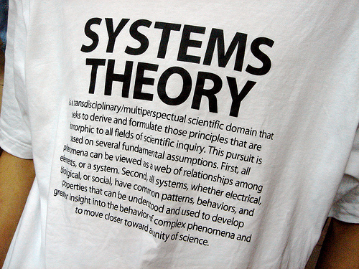

Slide 8

SSM process
Four steps to address a problematic situation:
  Finding out (the stakeholders and their concerns)
  Model building (explicating worldviews)
  Discussing and debating (accommadating worldviews)
  Taking action (improving the problematic situation)
In essence, this is a group learning process

Slide 9
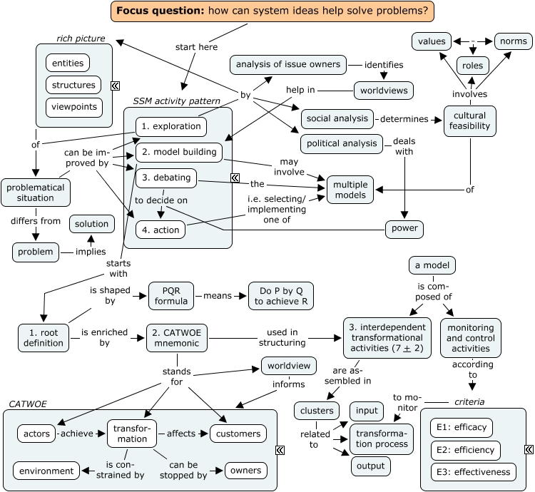
SSM overview

Slide 10
Responsieve Methdologie
Onderzoek is een dialogisch, interactief proces
  (Traditioneel: voor u, maar zonder u)
Onduidelijkheid over vraagstuk → vraagstukverheldering met alle betrokkenen
Vraagstukken zijn vaak complex met veel aspecten en nuances → narratieve aanpak
Ervaringskennis is belangrijk
Onderzoekskenmerken:
  Emergent design
  Hermeneutische-dialectische cirkels (proces van abductie)

Slide 11
Monoloog versus
Dialoog
Monoloog | Dialoog
Eenrichtingsverkeer | Tweerichtingsverkeer
Afstand | Betrokkenheid
Geen contact | Contact en reacties op elkaar
Inhoud onveranderd | Nieuwe gezichtspunten ontdekken
Partijen onveranderd | Samen leren en veranderen

Slide 12
Discussie versus
Dialoog
Discussie | Dialoog
Arena, strijdtoneel | Agora, marktplein
Standpunten innemen | Ervaringen delen
Gericht op winnen/verliezen | Gericht op leren van elkaar
Argumentatieve rationaliteit | Narratieve rationaliteit
Partijen | Mensen met namen en gezichten

Slide 13
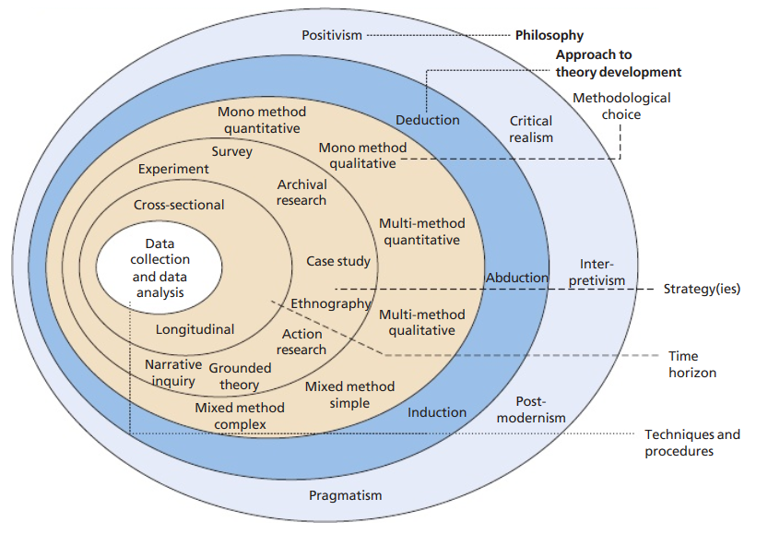
Research onion
(Saunders et al., 2015)

Slide 14

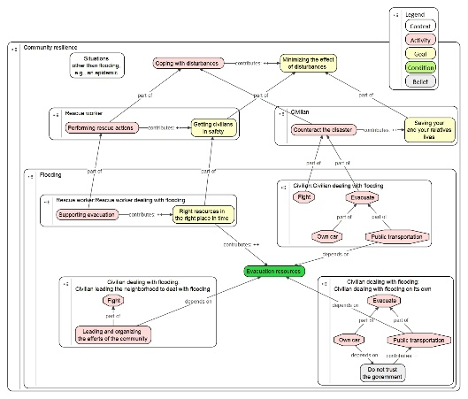
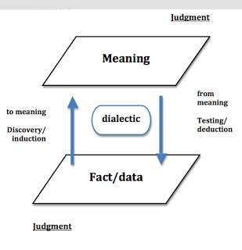

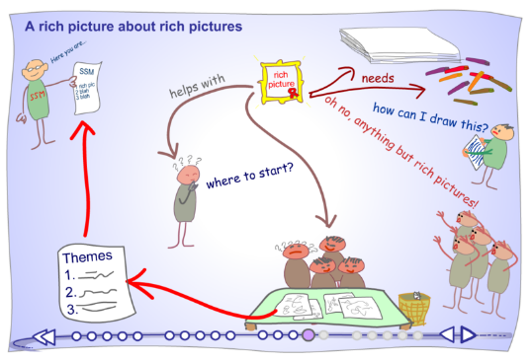
Abduction

Slide 15
Interview Guide
Why - Current literature
What - Semi-structured interview
How - Interview Topics List
How – Data transcription & analyses
Why – Link results from research to current situations

Slide 16
Qualitative research
& the semi-structured interview
Begin with an open mind, not an empty head
An interview is a conversation with a purpose

Slide 17
Interview structure
Introductory questions
  Introduce yourself
  Explain the aim of the interview
  Thank them for their cooperation
  Ask permission to record the interview
  Explain what happens to the information and assure it will stay anonymous
Prepared questions/topics – The Interview Topics List
Concluding comments
  Close the interview with some small talk, do not just stop after a serious conversation
  Thank the participant and make sure everyone is happy with the conversation
  Ask for contact details to follow-up
  Ensure again the information shall only be used for the purpose of this research

Slide 18
Asking the right questions
Be prepared – assemble a topic list
  start with max. 3- 4 very broad questions
  write memo’s from the start
  add more indepth questions over time
Get to the bottom – use the SSM/PQR formula (what, how, why)

Slide 19
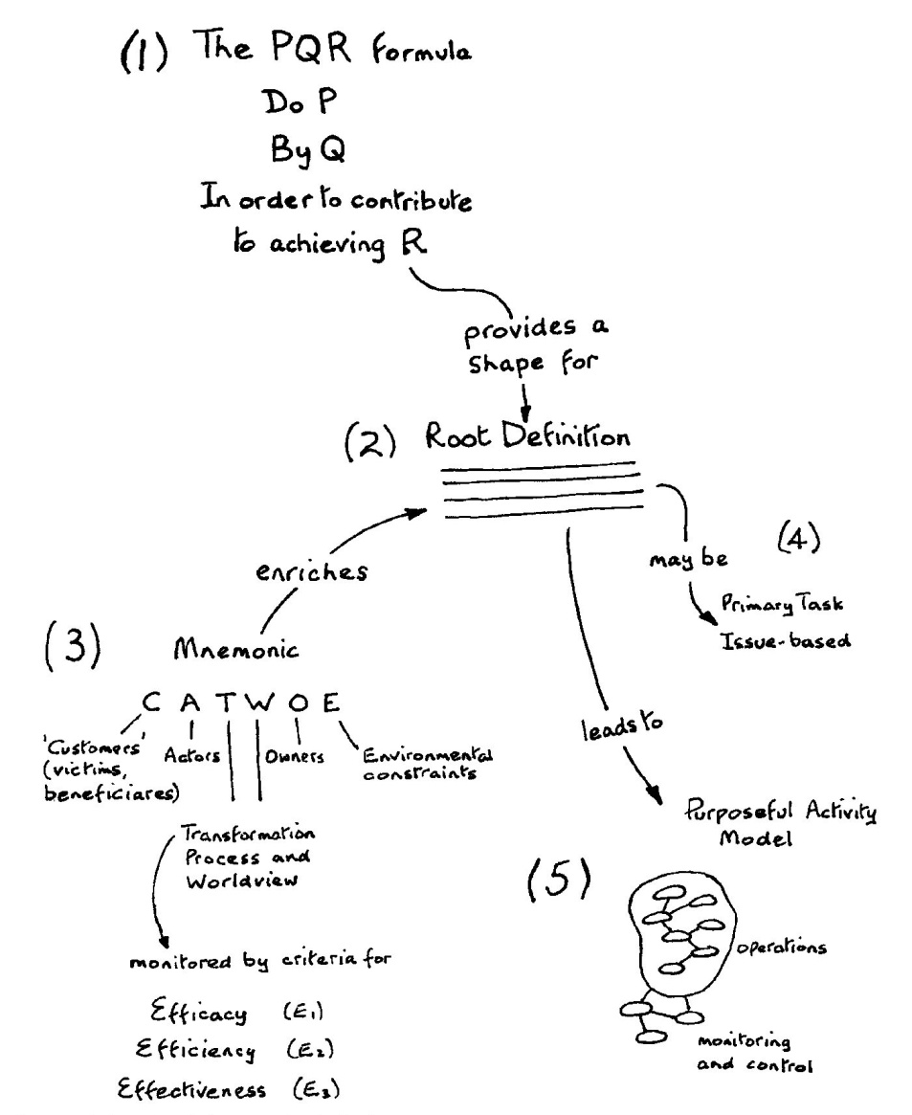
SSM/PQR

Slide 20
Topic list example
Topiclist: vragen voor de verkenning van wereldbeelden en mogelijkheden van betrokkenen in uitdagende situaties.
Voorbeeld topic list: I Know How project

Slide 21
Phrasing ad hoc interview questions
General rules
Types of questions
Questions should be easy to understand and be sensitive to background of participant
Questions should be short, clear and a neutral as possible.
Questions should not be factual and demand ‘yes’ or ‘no’ answers
  Phrase them so participants have the opportunity to talk rather than give short answers
Questions should contain one single question, not two at the same time
Behaviours
Opinions/values; what the person thinks about the topic
Knowledge; to get facts about the topic to support desk research
Feelings; what a person feels rather than what a person thinks

Slide 22

Interview probes
How can you make people say more
The silent probe
The uh-huh probe
Yes, I see
Right, uh-huh
Mmmm, hmm
Silent + Uh-huh = Strong combi
The more detail probe
The feelings & rational probe
Can you give me an example?
Can you tell me more about that?
How did others respond to this?
Why was that important to you?
How did you feel about that?
Why does that stand out in your memory?

Slide 23

Interview skills
“In order to gain access to the true thoughts and feelings of the participants, researchers adopt a non-judgemental stance towards the thoughts and words of the participants. The relationship should be built on mutual trust. The listener becomes the learner, while the participant is the teacher” (Holloway and Wheeler, 2011).
Make eye contact
Maintain a relaxed body language
Show interest in what people say
Emphasise & Encourage
LISTEN!

Slide 24
Recognising a difficult interview partner
Recognised difficulty | Suggestion
Participant appears willing only to give monosyllabic answers, these being little more than ‘yes’ or ‘no’ | Reasons for this are varied. If it is due to limited time, or worries about anonymity, then this can be minimised by careful opening of the interview. If the participant gives these answers despite such precautions, try phrasing your questions in as open a way as possible; also use long pauses to signify that you want to hear more.
Participant repeatedly provides long answers which digress from the focus of your interview | Although some digression should be tolerated, as it can lead to aspects about which you are interested, you will need to impose more direction. This must be done subtly so as not to cause offence, such as by referring back to an earlier relevant point and asking them to tell you more, or requesting that they pause so you can note down what they have just said.
Participant starts interviewing you | This can suggest that you have created rapport. However, you need to stress that you are interested in their opinions and that, if they wish, they can ask you questions at the end.
Participant becomes noticeably upset during the interview and, perhaps, starts to cry | You need to give your participant time to answer your question and, in particular, do not do anything to suggest that you are feeling impatient. If your participant starts crying or is obviously very distressed, it is probably a good idea to explain that the question does not have to be answered. Do not end the interview straight away as this is likely to make the participant even more upset.

Slide 25
Taking notes and recording the interview
Taking notes during the interview
Take notes on the content of the interview
The location of the interview (e.g. the organisation, the place)
The date and time
The setting of the interview (e.g. was the room quiet or noisy, could you be overheard were you interrupted?)
  Background information about the participant (e.g. role, post title, length of disease)
Your immediate impression of how well (or badly) the interview went (e.g. was the participant reticent, were there aspects about which you felt you did not obtain answers in sufficient depth?)
Recording the interview
Always ask your interview participant if they agree with recording the conversation. Explain why you would prefer to use a recorder rather than simply requesting permission.

Slide 26
Oefening
Oefening

Slide 27
Slot-opmerkingen
Responsieve methodologie, narratieve aanpak:
een genuanceerd beeld van wat speelt bij mensen in bepaalde situaties: overtuigingen, aannames, dilemma’s, etc.
Iteratief proces (abduuctie)
Emergent design

