Slide 1






9 Resource Strategies
FACET 05.12.2020

Slide 2
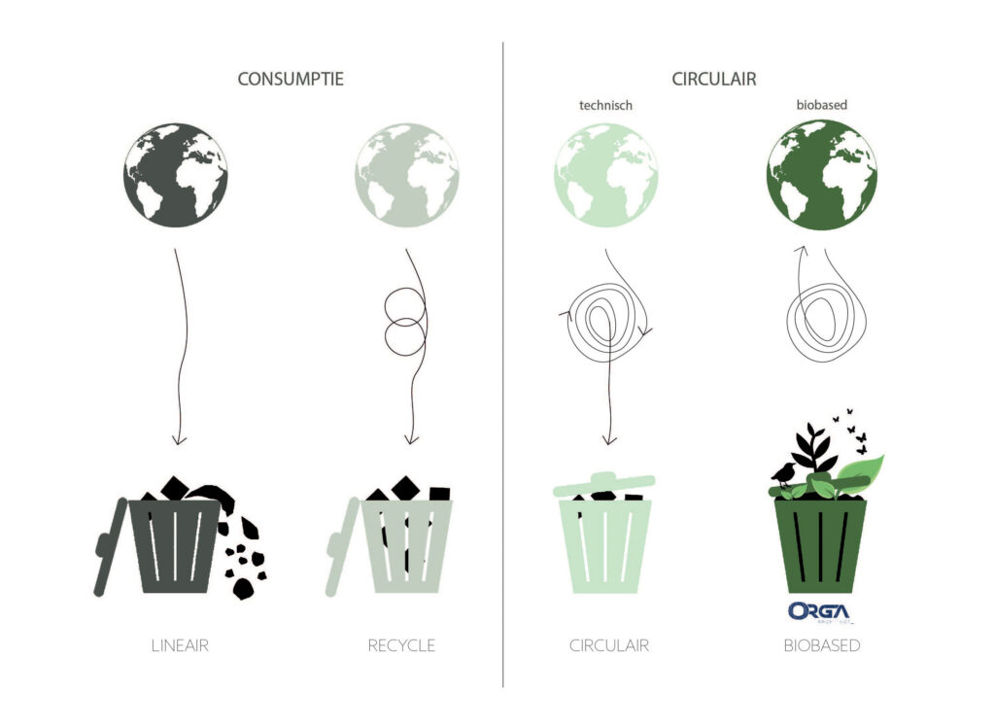

Slide 3

Strategies in a Circular Economy
Circular economy
Smarter product use and manufacturing
R0 Refuse
Make a product redundant: abandon function or use different product
R1 Rethink
Make product use more intensive: sharing or multifunctional products
R2 Reduce
Consume less through efficient manufacturing or use
Extent lifespan of products and its parts
R3 Re-use
Re-use of functioning discarded products by another use
R4 Repair
Repair and maintenance of defects to keep original function
R5 Refurbish
Restore and update
R6 Remanufacture
Use part in new product with the same function
R7 Repurpose
Use products or parts in new product with a different function
Useful application of materials
R8 Recycle
Process materials to obtain the same (high grade) or lower (low grade) quality
Linear economy
R9 Recover
Incineration of materials with energy recovery

Slide 4


R0 Refuse
Make a product redundant; abandon function or use different product
Prevent any environmental damage by refusing to accept or support products or companies that harm the environment
One example is to refuse items that are over-packaged or packaged in plastic
And sometimes items may not be necessary overall…

Slide 5
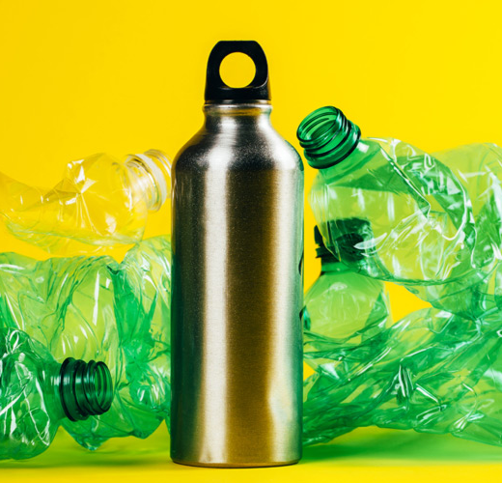
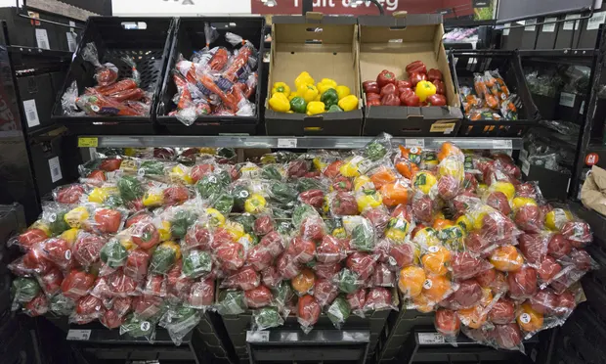

Slide 6

R1 Rethink
Questioning the assumptions behind the current economic & business logic
Changing production-consumption systems from linear (take-make-waste) to circular (everything stays in the biological or technical loops)
Preserving our stock of material resources by eliminating waste, promoting resource efficiency and moving towards a circular economy
Make product use more intensive: sharing or multi-functional products
Minimize the damage caused to our natural environment by reducing and managing waste safely and carefully

Slide 7


Slide 8

R2 Reduce
Consume less through efficient manufacturing or use
Reducing the number of resources used in everyday life is the next step in the resource management hierarchy
You can reduce your energy usage, water usage along with reducing your garbage, food waste, plastic, and transportation

Slide 9
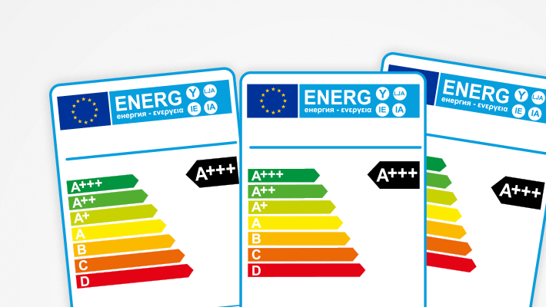
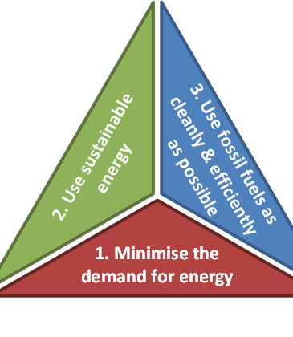
1. First energy saving (reduction)
2. Increase of renewable energy
3. Improved efficiency of the production of energy from fossil sources

Slide 10

R3 Re-use
Re-use of functioning discarded products by another use
Re-use is the action or practice of using an item, whether for its original purpose (conventional reuse) or to fulfil a different function

Slide 11
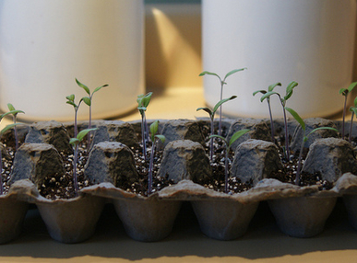

Slide 12

R4 Repair
Repair and maintenance of defects to keep original function
More attention for contractual agreements for maintenance and repair within (joint) purchase processes
Service agreements with suppliers
Interesting in combination with products-as-service models

Slide 13
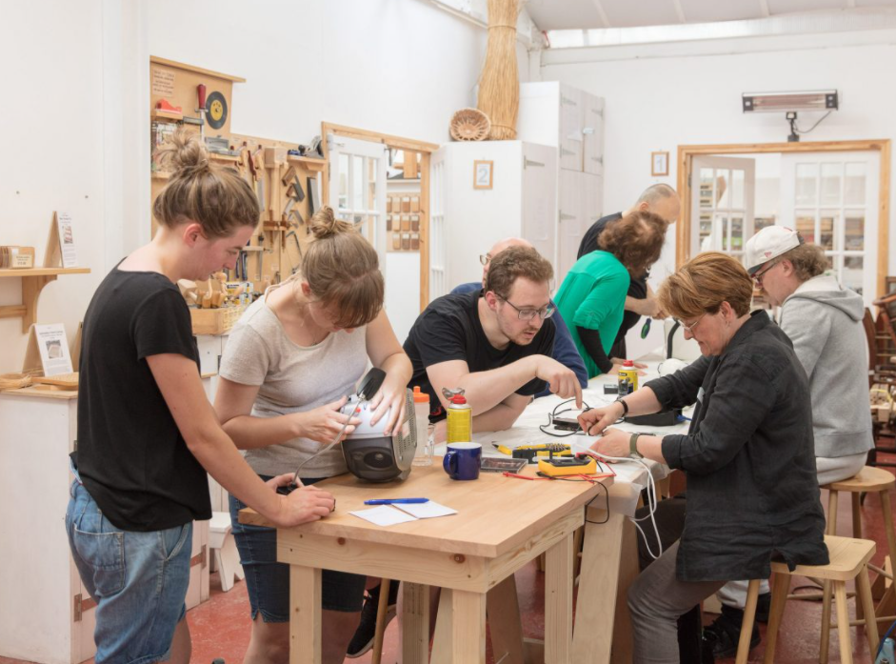

Slide 14

R5 Refurbish
To refurbish a building or room means to improve it by cleaning, decoration, restoring and/or updating its function and as such making it more attractive or better equipped
Refurbishment is often aesthetic in nature
This process is typically less intensive than remanufacturing, which results in a final product comparable to a brand-new product which often possess the same warranties and guarantees as a new product
You can refurbish houses, furniture, kitchens but also electronics like cell phones or laptops

Slide 15
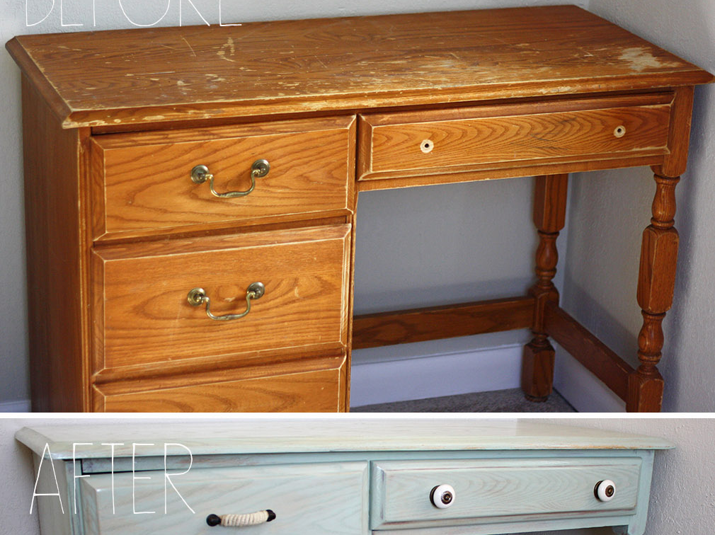
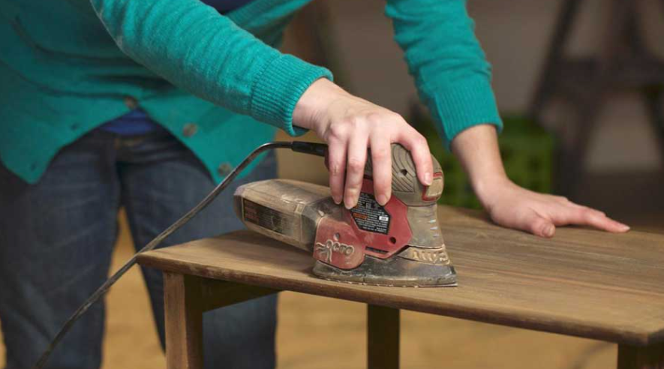


Slide 16

R6 Remanufacturing
Use parts in a new product with the same function
It is the process of recovering, disassembling, repairing and sanitizing components for resale at ‘new product’ performance, quality and specifications
By remanufacturing products, components or parts, a company contributes to the circular economy by extending the lifetime of those elements and creating value
Economic drivers for remanufacturing may include reduced costs of goods sold, reduced prices to the customer, supply risk mitigation and stronger value chain relationships.

Slide 17
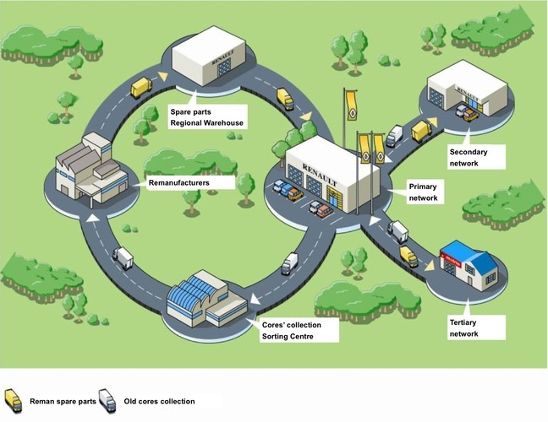

Example: Remanufacturing plant
in Choisy-le-Roi, France
Damaged parts (scraps) from vehicles currently in use are being collected through the commercial reverse logistic network
Remanufactured parts have the same guarantee and are submitted to the same quality control tests as new parts and 30-50% cheaper
Notes:
https://www.ellenmacarthurfoundation.org/news/the-circular-economy-applied-to-the-automotive-industry-2

Slide 18
R7 Repurpose
Use products or parts in a new product with a different function
Examples:
Real estate, including land and buildings, is routinely adaptive reused for other purposes, both short-term and long-term, due to its high fixed cost. An example is conversion of old industrial mills
Scrap metal and furniture have countless applications for repurposing
Waste like plastics and wood can be repurposed in several ways, including art and toys

Slide 19
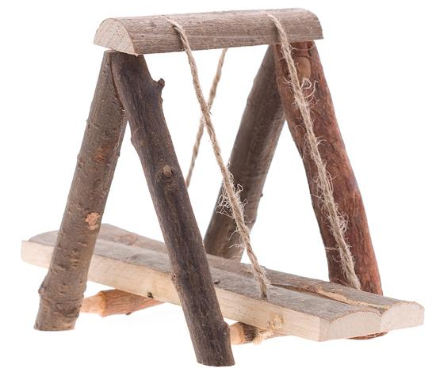
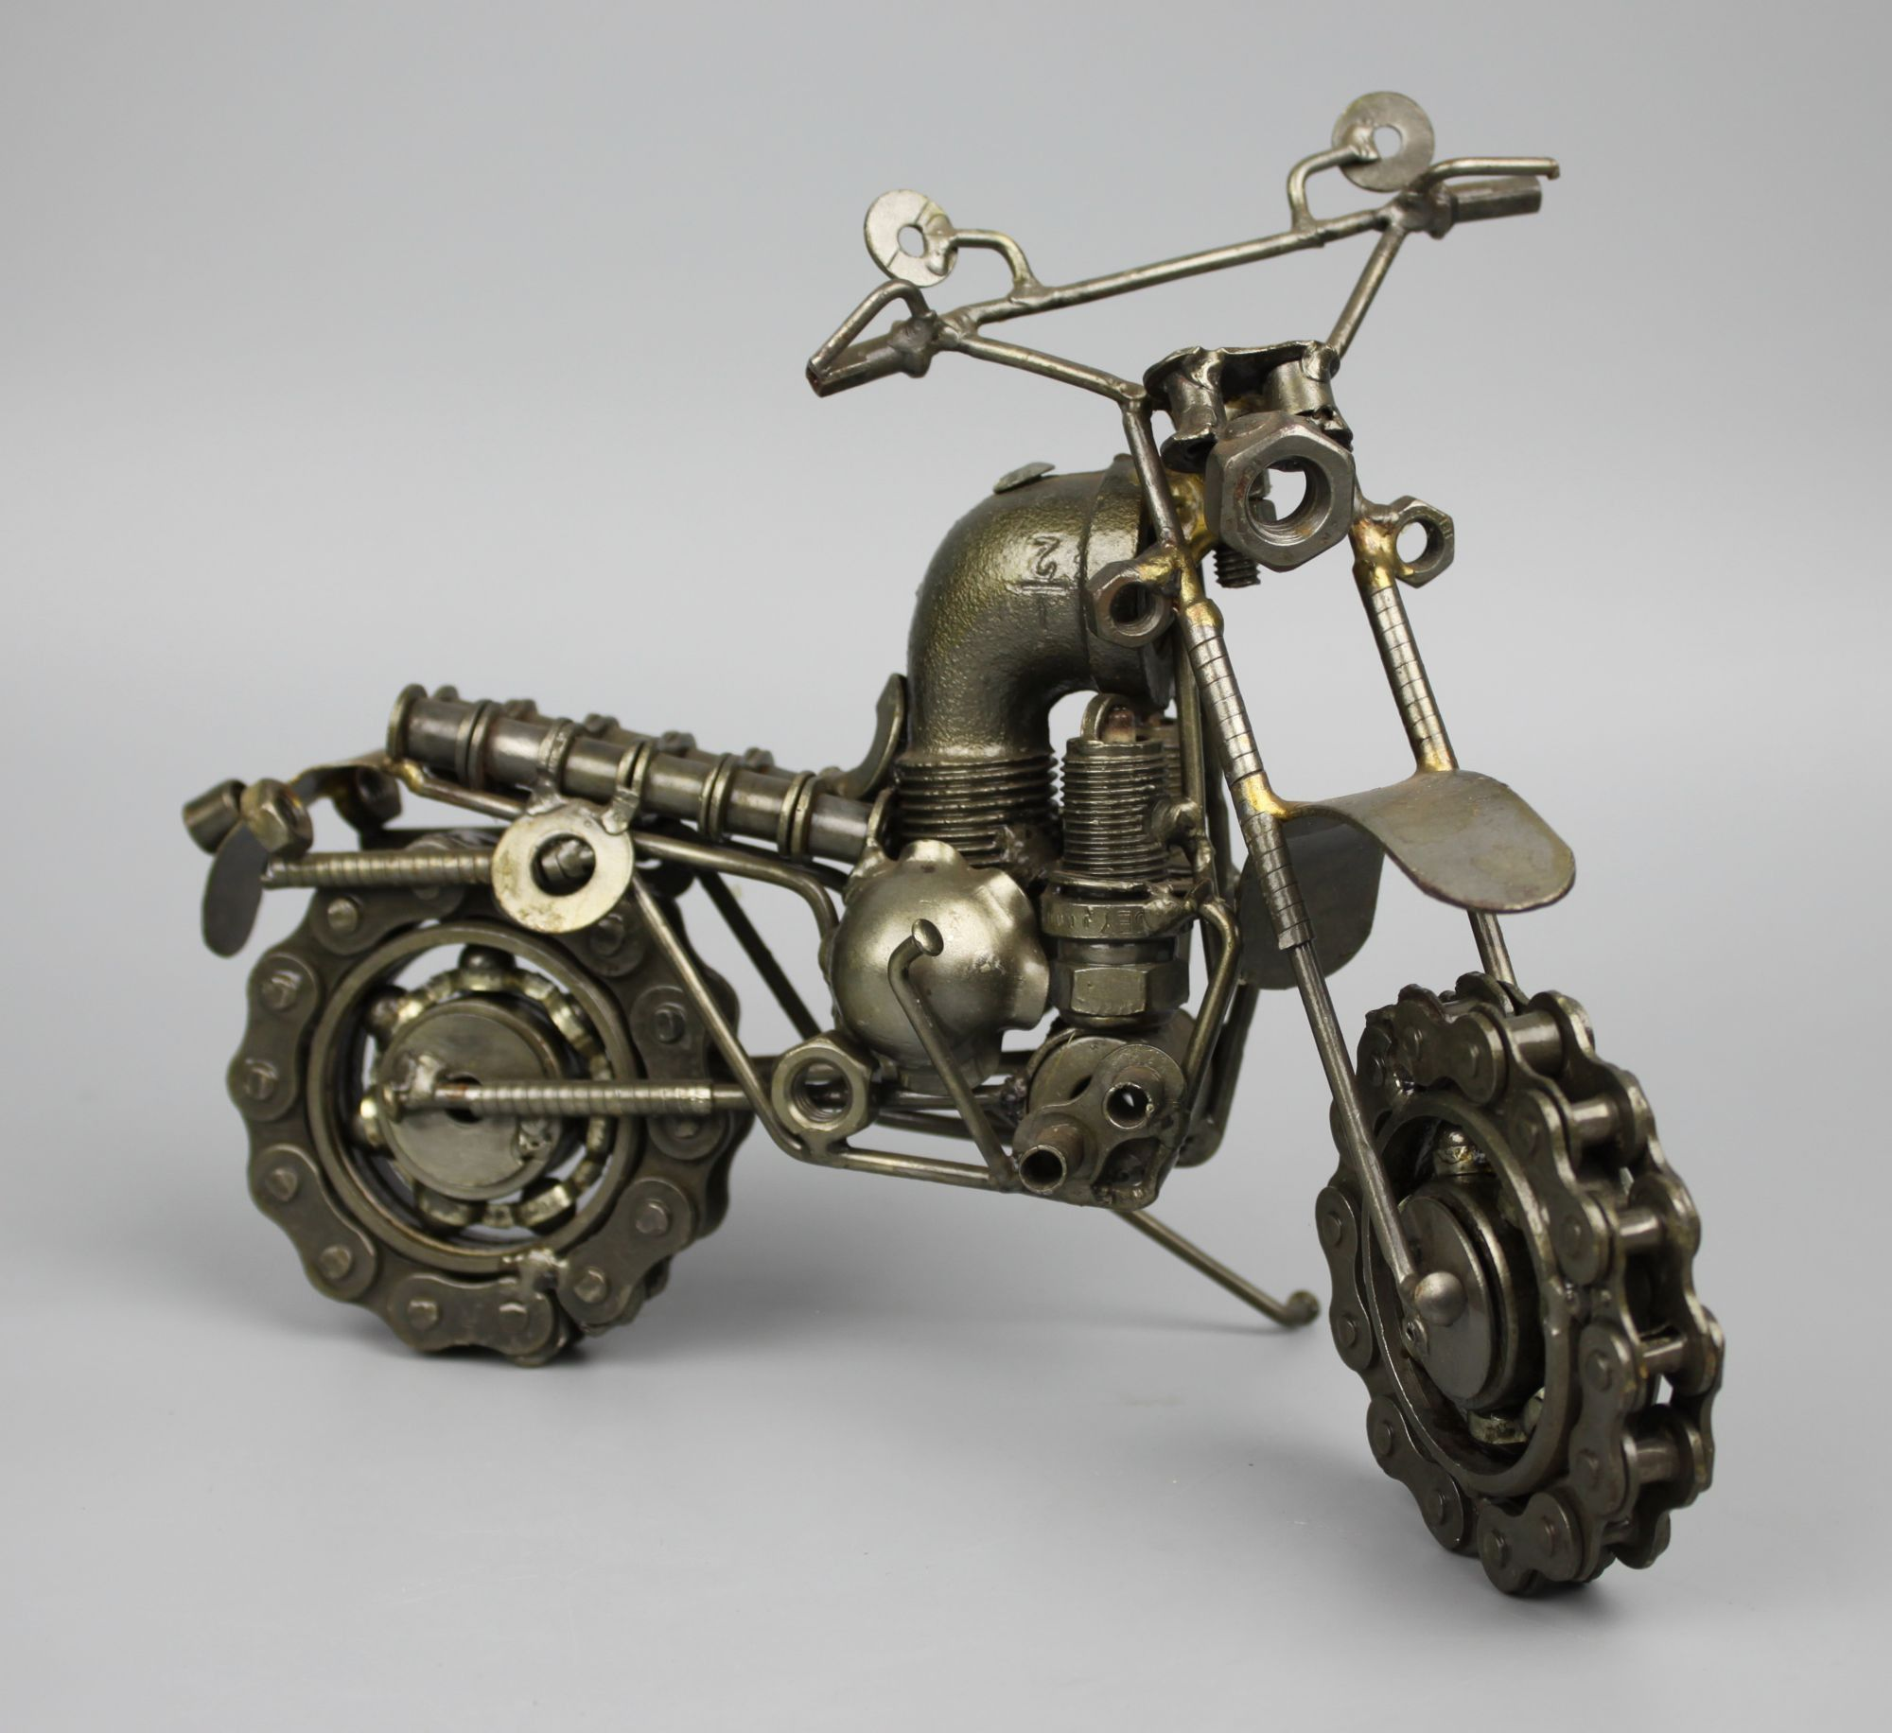
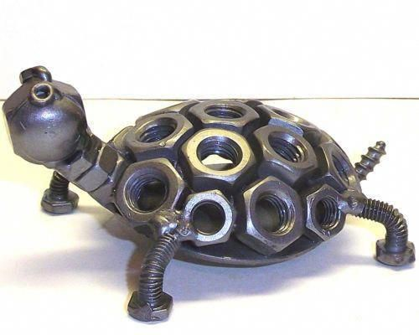
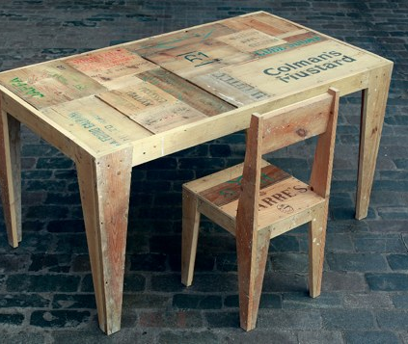
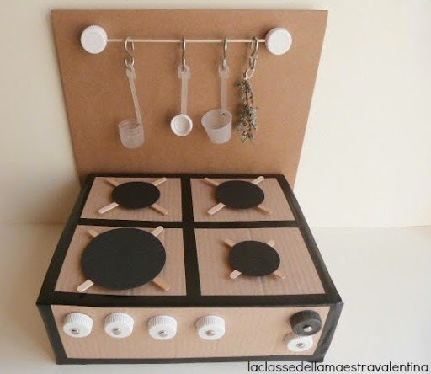
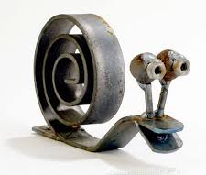
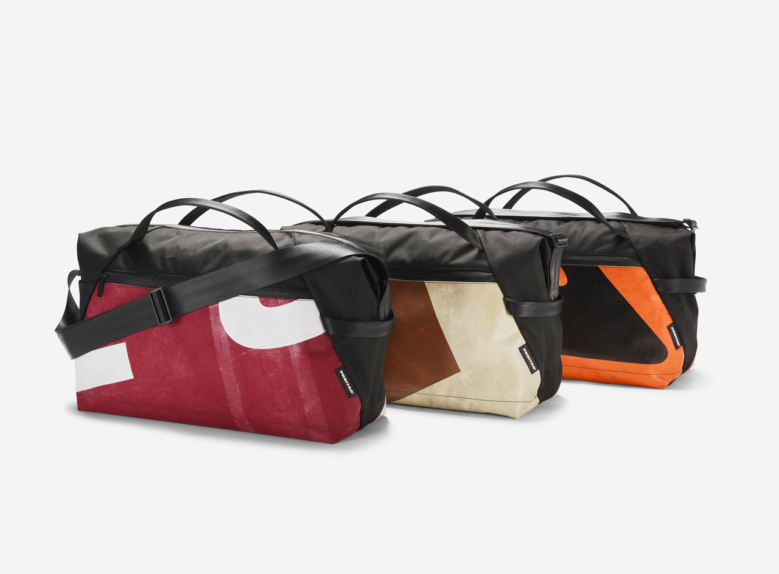

Slide 20

R8 Recycle
Process materials to obtain the same (high grade) or lower (low grade) quality
Only about 9 percent of the 9.9 billion tons of plastic generated globally since the 1950s has been recycled, according to the United Nations Environment Programme
Almost half of the plastic waste poisoning marine life, contaminating food, and clogging waterways and sewers comes from consumer packaging

Slide 21
FREITAG turns old truck tarps into sports bag

Slide 22



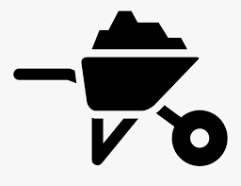
R9 Recover
Processing materials with goal to recover energy or materials
The recovery strategy is the last option within the production-consumption system to save some embedded energy or materials
After this stage there is only the landfill (burying waste)

Slide 23
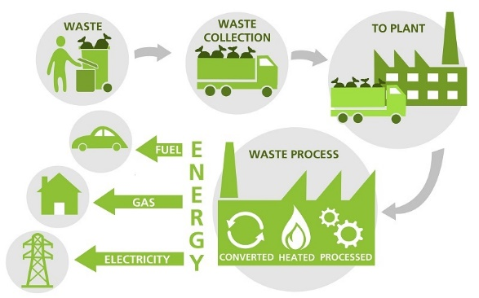
Recovery process
Source: https://cleanleap.com/recovering-energy-waste-can-power-africa

Slide 24
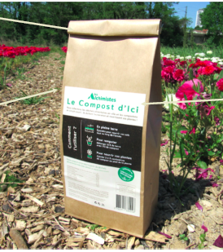

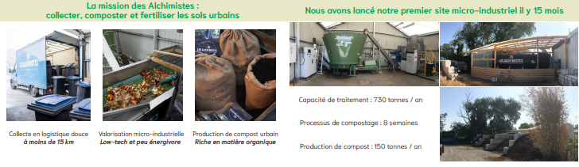
Alchemist (France)
Compost from bio-waste
Notes:
The Alchimistes is a young, innovative startup in Paris, France that offers organic waste collection for restaurant, cafeteria, office, schools e.g. and sells it as fertile ground (compost) to businesses like wholesalers and garden centers. The companies business model has proven to be viable after five years.

Slide 25
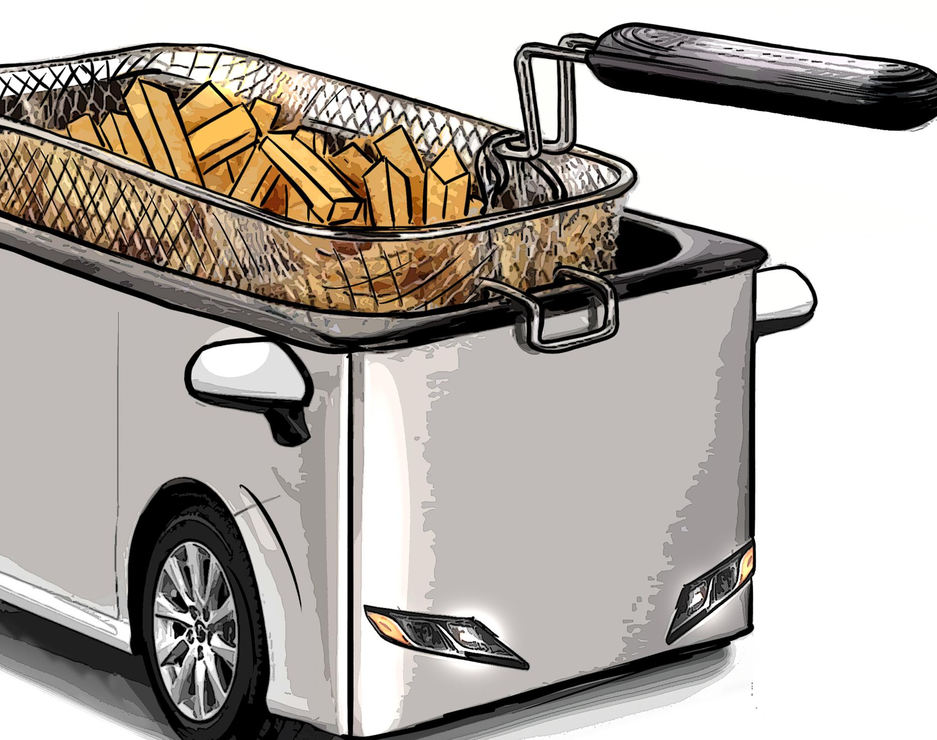
Biofuel from frying oil?

Slide 26
Thank you!

